Slide 1
Application of Context to Fast Contextually Based Spatial Authentication Utilizing the Spicule and Spatial Autocorrelation
Gregory Vert CISSP
gvert12@csc.lsu.edu
Texas A&M Central Texas*
Jean Gourd
jgourd@latech.edu
LaTech*
S.S. Iyengar
iyengar@csc.lsu.edu
Louisiana State University*
*and Center for Secure Cyber Space

Slide 2
Overview
GOAL – make the already fast Spicule spatial authentication method faster using the newly developed Contextual Processing model integrated with spatial autocorrelation
Presentation:
  Spicule Background
  Context Background
  Spatial Autocorrelation (Moran’s method)
  Integration and Approach

Slide 3
Spicule Background and Properties
Invented by Vert, 2002
Goal to detect intrusions
Mathematics were very fast
  vector based
  integer based +, - fastest operation on CPU
    real time detection possible
Turned out to be a model of State Change in a system
  can model state changes over time
  can support real time state change and detection

Slide 4
Spicule Properties
Can model thousands of variables at the same time and REDUCE data to only what has changed
Visually intuitive model of human behavior
  models sort of, kind of, not like – analysts way of interpreting the image.
Capabilities:
  Rapid (based on +,- cpu integer operation) DIP (Detection, Identification and Prediction of CHANGE)

Slide 5
Spicule Terminology – Equatorial View
Tracking vector tv_{b} e.g. disk reads/10 s
Tracking vector tv_{a} = {0,100} e.g. cpu usage
Fixed vector v_{a} = {1,∞}, e.g. #users logged in
Fixed vector v_{b} e.g # packets arriving / sec.
Zero Form – result of F₂-F₁ when F₁=F₂ → ¬ ∆

Slide 6
Spicule Terminology – Polar View,
Notes:
Radial arrangement of features vectors is arbitrary as long as there is a protocol
Ball color and size MAY be connected to security metrics for a given host or NETWORK, operator certification, threat level, etc.

Slide 7
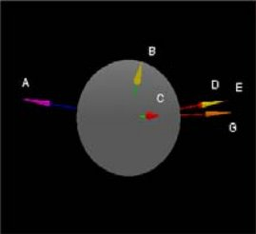
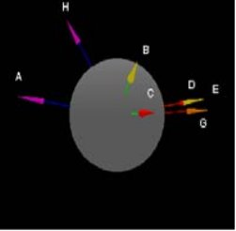
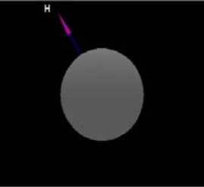
-
Algebra of Detection (D) of Change
in a System
Form T₁
Form T₀
=
Change Form

Slide 8
-
Algebra of Identification(I) and Classification of the Change in System
Attack Form, from library of known attacks
Change Form
=
Identification Form – Backdoor Sub 7 Trojan, Interpretation, pretty close, “probably sub 7 related” HUMAN Speak,… a related type of attack

Slide 9
Spicules and Time Series Analysis
Interdiction and Analysis T₃ (T is an arbitrary time interval)
Form T₀
Form T₁
Form T₂
Form T₄
Forms can have the Analysis Algebra applied anywhere over T_{T1} – _{T4}
Analysis thus can be contextually analyzed based on temporality

Slide 10
Prediction (P) Loops Back to Identification
+
Form T₁
Attack Form Back Door Sub 7
=
Predict Form :
Alg
Generate Pform
Monitor for Pform – Form T_{n} = Zero Form
When TRUE Respond

Slide 11
Spicule Application to Authentication
Authentication is a method of determining whether an data item has been modified
Important because use of modified data can cause:
  Damage – military
  Expense - urban planning
Methods to protect spatial data:
  Encryption
  Hashing
  Signatures

Slide 12
Goals for Spatial Authentication
Method needs to be fast, ideally faster than standard encryption methods
  Infeasible computationally to encrypt and authenticate all spatial data especially if its streaming – encryption meant to work on relatively small amounts of data.
Not all objects may need to be authenticated
  Reduction in computational overhead – voluminous spatial data

Slide 13
Spicule’s Application to Authentication
Developed notion of a collection of vectors pointing to spatial objects could create a collective mathematical signature useful for authentication
Algorithm:
  A) Generate vector signature A
  B) Transmit spatial data and signature (encrypted – if desired)
  C) Generate vector signature of received data B
  D) Subtract B-A, and visualize the change
  E) The Amount of change will visualize as vector(s) one a sphere
  F) If no change (authentication) then no vectors appear

Slide 14
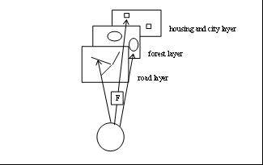
Previous Work

Slide 15
Comparison of Approach v. Standard Methods
Test Result – appears to be faster, must faster than encryption using Crypto+ on PC

Slide 16
Contextual Processing
Def. Knowledge derived based on an information object and the relationship of environmental data related to the object
(LSU colors ☺)
Dimensions – what can uniquely classify a contexts information
  temporality – defined to be the time period that the event unfolded over from initiation to conclusion
  similarity – the degree to which contextual objects are related by space, time or concepts
  spatiality – defined to be the spatial extent, regionally that the event occurs over.
  impact – the direct relationship of contextual object to results, damage, policy change, processing protocols, because of a contextual event.

Slide 17
Contextual Models
Contextual *Models Developed to Date:
  Storage and management
  Logic
  Data mining
  Hyperdistribution
  Security
  Data mining quality
  *Vert, Iyengar, Phoha, Introduction to Contextual Processing: Theory and Application, Taylor and Fransis November 20, 2010

Slide 18
Integration with Spatial Correlation an Example
The application of local autocorrelation and context might follow the logic that
  i) a user wants to retrieve object for a given location in space and or in a given time period for that location.
  ii) the object the user might want to look at are of a given class with heterogeneous members. For example:
O = {tank, half trac, jeep, jeep with gun mount, armored personal carrier}
where:
O – is set of battlefield objects with wheels, represented in a
spatial data set with spatiality attributes
Note that within this class there are implications for similarity from the context model such as members that can fire projectiles and members that transport resources.

Slide 19
Query Against Set O Example
Consider that a user is interested in query Q₁:
Q₁ = ( the location of the majority vehicles with guns on them, T_{eo})

Slide 20
Integration of Context with Spicule’s Authentication
Spatial Autocorrelation looks at the degree of similarity (correlations) as a function spatial dependency
localized Moran spatial correlation coefficients
where:
z_{i} = x_{i} -
s – is the standard deviation of x
W_{ij} - is the contiguity matrix, normalized, or based on similarity

Slide 21
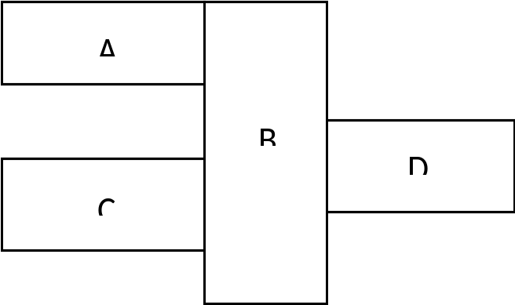
Adjacency Lattice of Spatial Ojbects
Given the following lattice of spatial objects: (e.g. Vehicles with guns, transport vehicles)

Slide 22
Contiguity Matrix Setup W_{ij}
Calculation of W

Slide 23
Localized Correlation and T_{eo}
Merging Context
T_{eo} a concept from the Context model. An object (spatial or temporal dimension) of interest utilized in a query or analysis
A calculated localized spatial autocorrelation matrix I_{i}
 | A | B | C | D
A | 0 | .82 | 0 | 0
B | .79 | .8 T_{eo} | .5 | 1
C | -.2 | .23 | .4 | 0
D | 0 | 1 | -.6 | 0

Slide 24
Selection Criteria on Spatial Correlation Matrix
Variety of methods some could include application of one of the following criteria:
  similar values,
  above a floor value,
  below a ceiling value
  falling into a bounded range
As an example coefficients of .8 ± .2, and a region produces {.82, .79, .8} Spatial authenticate these objects.
Approach will result in N regions of objects that will need Spicule Authentication

Slide 25
Integration of Context How ?
Integrates the dimension of spatiality where the location of the objects affect the type of object found and thus what is authenticated by Spicule – spatial dependency
Integrates the dimension of similarity in the groups of similar objects will be found in spatial regions

Slide 26
Some Future Work
Granularity of objects in the lattice cells classes of object v single objects ?
Many ways to build the W matrix to be explored for performance, what is retrieved.
  Method randomly populated spatial data.
Integration of dimension of temporality from context showing how groups change over time
  Initial ideas about this
Characterizations of object motions and class types to be integrated
Need a framework to decide what objects should be authenticated and how that is decided

Slide 27

Questions

